Slide 1
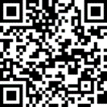
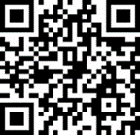
Attending a Meeting?
Make Your Stay Your Own.
Join Marriott Bonvoy™ for exclusive benefits (and a mobile app*) that make travel easy.
Join for Free Today
Complimentary Wi-Fi
Stay connected everywhere, for free.
Check In on the App
Check in from anywhere and get notified when your room is ready.
Unlock Your Room
Use Mobile Key to unlock your room, fitness center, pool, and more.
Chat With Us
Ask questions or get recommendations.
Make Requests
Chat with your hotel or make requests.
Order Food
Browse the menu & order room service.
More Points
Earn points on everyday spending with Marriott Bonvoy credit cards.
Earn and Redeem
Earn points on stays and purchases & redeem for free nights and more.
Download the App
*Mobile app feature availability varies by hotel brand and property.
*Benefits may vary by brand and location.
©2022 Marriott International, Inc. All Rights Reserved.

